Slide 1

ELK: Ruminating On Logs
Mathew Beane
Midwest PHP 2016 – March 4th 2pm

Slide 2

Mathew Beane
@aepod
Director of Systems Engineering - Robofirm
Magento Master and Certified Developer Zend Z-Team Volunteer – Magento Division Family member – 3 Kids and a Wife
Notes:
Life long computer geek
First computer build 1980’s
First linux install 1994 (slackware linux 1.0 days)
Learned solaris for video game industry work
Moved to Server Room work
PHP in 2000
Ecommerce in 2006
Magento 2008

Slide 3

Now hiring talented Minions… err Programmers.
The digital agency innovating content, commerce, and user-centered experiences.
http://www.robofirm.com/
Notes:
Robofirm is a Magento Solutions provider and a Magento Partner focused on Mid-level to Large Enterprise clients. Based out of New York City, however the bulk of our developers are in Dallas or Minneapolis.

Slide 4

Todays Plan
ELK Stack Overview
Installing ELK
Production ELK Considerations
Logstash & Log Shipping
Kibana and Other Visualizations

Slide 5
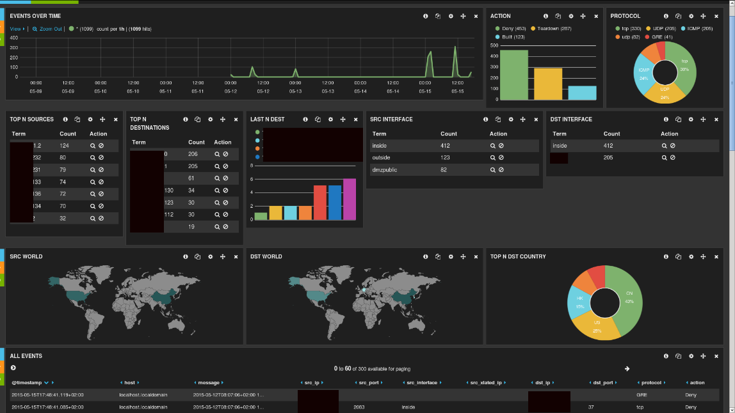
ELK Overview
Elasticsearch: NoSQL DB Storage
Logstash: Data Collection & Digestion
Kibana: Visualization standard.
Typical Kabana Dashboard: Showing a Cisco ASA network interface.
Simple ELK Stack data flow.
Notes:
Logstash and Log shippers!!!!

Slide 6
ELK Versions
Right now everything is a mishmash of version numbers.
Soon everything will be version 5, which will be helpful.
Learning all the logos is a little bit like taking a course in Hieroglyphics.
Elastic has hinted that the naming will become simplified in the future.
Oh look, yet another round of new Logos.
From the Elastic Website

Slide 7

Elastic Subscription Services

Slide 8
ELK Stacks
Elasticsearch: Yes, cluster it.
Logstash: Yes, you will find it installed several times through the stacks.
Kibana: Typically not needed. Although you will want to plug in other visualizers.
Other Stack Components
Brokers: Redis, RabbitMQ
Logshippers: Beats, rsyslogd and others.
Visualization: Utilize Graphana or Kibana plugins, the sky is the limit.
Elk are not known for their stack-ability.

Slide 9

Elasticsearch
Open Source
Search/Index Server
Distributed Multitenant Full-Text Search
Built on top of Apache Lucene
Restful API
Schema Free
Highly Available / Clusters Easily
json Query DSL exposes Lucene’s query syntax
https://github.com/elastic/elasticsearch

Slide 10

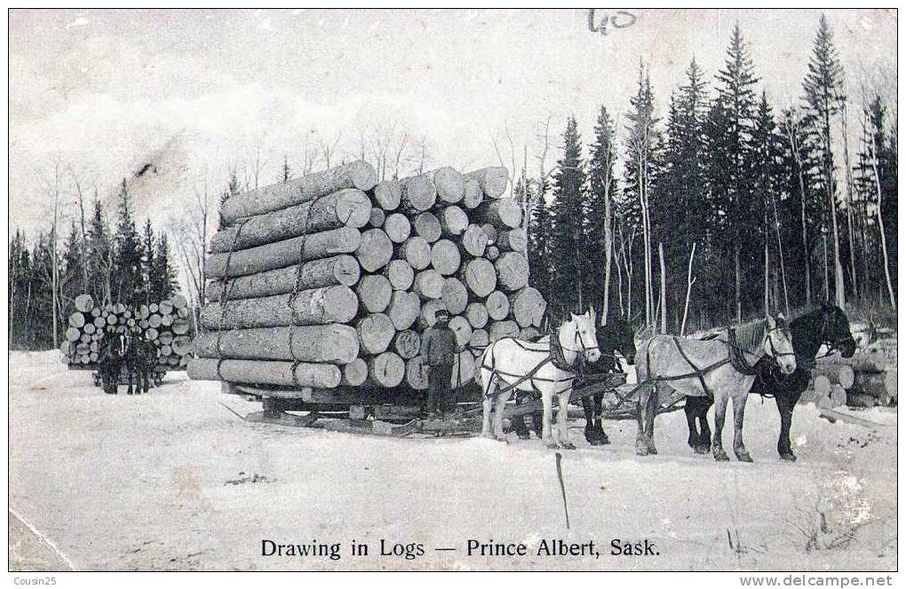
Logstash
Data Collection Engine
Unifies Disparate Data
Ingestion Workhorse for ELK
Pluggable Pipeline:
Inputs/Filters/Outputs
Mix and Match as needed
100’s of Extensions and Integrations
Consume web services
Use Webhooks (Github,Jira,Slack)
Capture HTTP Endpoints to monitor web applications.
https://github.com/elastic/logstash

Slide 11


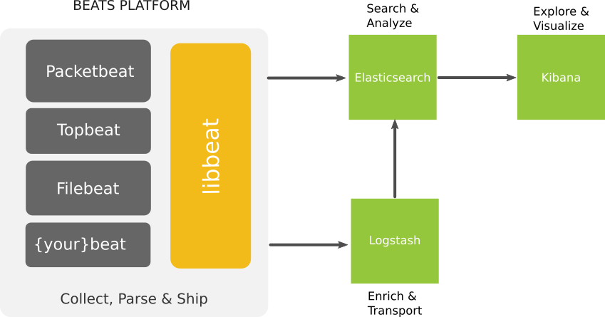

Beats
Lightweight - Smaller CPU / memory footprint
Suitable for system metrics and logs.
Configuration is easy, one simple YAML
Hook it into Elasticsearch Directly
Use Logstash to enrich and transport
libbeat and plugins are written entirely in Golang
https://github.com/elastic/beats
Notes:
Go is an open source programming language that makes it easy to build simple, reliable, and efficient software.

Slide 12

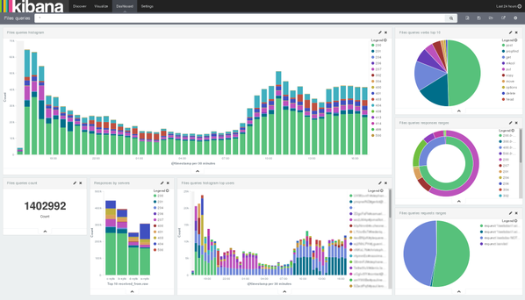
Kibana
Flexible visualization and exploration tool
Dashboards and widgets make sharing visualizations possible
Seamless integration with Elasticsearch
Learn Elasticsearch Rest API using the visualizer
https://github.com/elastic/kibana

Slide 13
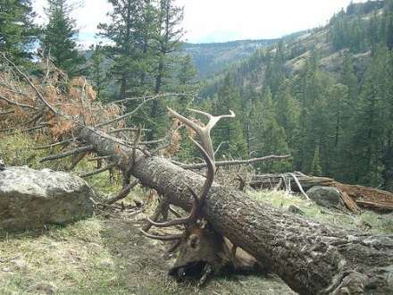
ELK Challenges
Setup and Architecture Complexity
Mapping and Indexing
Conflicts with naming
Log types and integration
Capacity Issues
Disk usage over time
Latency on log parsing
Issues with overburdened log servers
Truck Factor
Health of Logging Cluster

Slide 14

ELK as a Service
5 Minutes setup – Just plug in your shippers
14 day no strings attached trial
Enterprise-Grade ELK
Alerts
S3 Archiving
Multi-User Support
Reporting

Slide 15
ELK Example Installation
Install Procedure
Install Server Stack (30 Minutes)
Install Java
Install Elasticsearch
Install Logstash
Create SSL Certificate
Configure Logstash
Install Kabana (30 Minutes)
Install /Configure Elastic Kabana
Install / Configure Nginx Proxy
Install Client Server (20 Minutes)
Add SSL Certificate
Install Elastic Beats
Configure and start Filebeats for logs
Kibana Configuration (5 Minutes)
Configure Kabana Index
Add Filebeat Index Template
Start using Kabana
* Time to complete results may vary
Client Servers
Elastic Beats
Filebeat
ELK Stack Server
Java 8 (Prerequisite)
Elasticsearch
Logstash
Kibana
Nginx Fastcgi Proxy
https://www.digitalocean.com/community/tutorials/how-to-install-elasticsearch-logstash-and-kibana-elk-stack-on-centos-7
https://www.digitalocean.com/community/tutorials/how-to-install-elasticsearch-logstash-and-kibana-elk-stack-on-ubuntu-14-04

Slide 16
ELK Server Install – Elastic Components
Install Java Typically install Oracle Java 8 via your preferred package manager. OpenJDK should work as well.
Install Elasticsearch Elasticsearch can be installed via the package manager, add the elastic GPG Key and the repository, then install it. Literally no configuration is needed to make it work enough for ELK Stack. *except step 6 below
Install Logstash Installed from the same repository as Elasticsearch.
Create SSL Certificate Filebeats Requires an SSL certificate and keypair. This will be used to verify the identity of the ELK Server.
Configure Logstash Add beats input, syslog filter, and elasticsearch output.

Slide 17
Logstash Configuration Examples
Notes:
From beats, through the syslog filter into the elasticsearch output.

Slide 18
ELK Server Install – Kibana Install
Install Kibana The elastic GPG should have been added during the initial install. Install from the package manager.
Configure and Start Kibana In the kibana.yml change server.host to be localhost only, because nginx will be connect to it via localhost.
Install Nginx Typical Nginx install, you may want apache2-utils which provides htpasswd.
Configure and Start Nginx Basic Nginx proxy configuration, Kibana handles the requests.

Slide 19
ELK Install – Client Stack
Copy SSL Certificate in from Server You will want to place the crt file from the certificate you generated in in /etc/pki/tls/certs/
Install Elastic Beats As before, you will need to add the GPG Key and Repository before installing any of the beats. Install the filebeat package and move onto the configuration.
Configure and Start Filebeat for logs Take a look at the /etc/filebeat/filebeat.yml and modify the sections according to the Digital Ocean blog article.
Modify Prospectors to include /var/log/secure and /var/log/messages
Modify the document type for these to be syslog *Matches Logstash type
Modify the logstash host to reflect your logstash server
Add your certificate path to the tls section

Slide 20
Filebeats Configuration Examples
server
https://gist.github.com/thisismitch/3429023e8438cc25b86c
client
Logstash input/filter/output

Slide 21
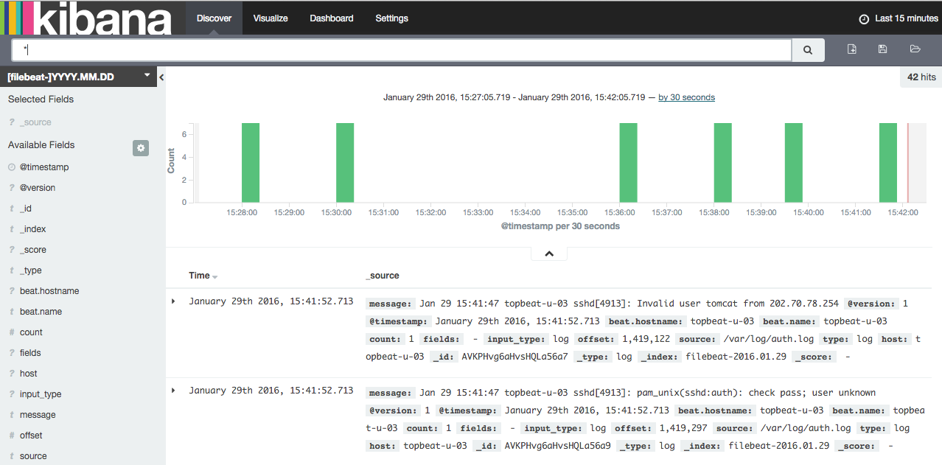
ELK Install – Kibana Config
Initialize Kabana Index
Install filebeat-index-template.json into Kabana
Start Using Kabana

Slide 22

Elasticsearch at Production Scale
OS Level Optimization: Required to run properly as it is not performant out of the box. Index Management: Index deletion is an expensive operation , leading to more complex log analytics solutions. Shard Allocation: Optimizing inserts and query times requires attention. Cluster Topology and Health Elastic search clusters require 3 Master nodes, Data nodes and Client nodes. It clusters nicely but it requires some finesse. | Capacity Provisioning: Log bursts, Elasticsearch catches fire. Dealing with Mapping Conflicts: Mapping conflicts, and other sync issues need to be detected and addressed. Disaster Recovery: Archiving data, allowing for a recovery in case of a disaster or critical failure. Curation: Even more complex index management, creating, optimizing and sometimes just removing old indices.
Notes:
~4-6 weeks of work

Slide 23
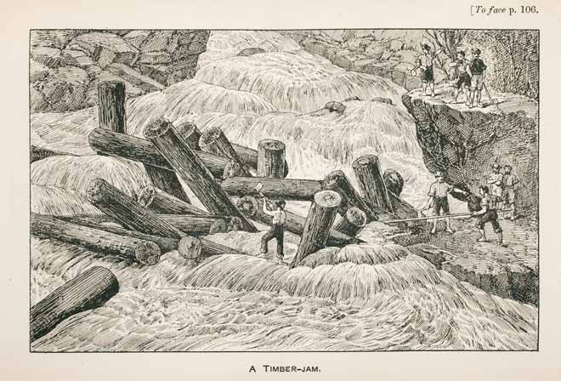
Logstash at Production Scale
Data parsing: Extracting values from text messages and enhancing it. Scalability: Dealing with increase of load on the logstash servers. High Availability: Running logstash in a cluster is less trivial than Elasticsearch. * | Burst Protection: Buffering using Redis, RabbitMQ, Kafka or other broker is required in front of logstash. Configuration Management: Changing configurations without data loss can be a challenge.
* See: https://www.elastic.co/guide/en/logstash/current/deploying-and-scaling.html
Notes:
~4-6 weeks of work

Slide 24
Kibana at Production Scale
Security: Kibana has no protection by default. Elastic Shield does offer very robust options. Role Based Access: Restricting users to roles is also supported via Elastic Shield if you have Elastic Support. High Availability: Kibana clustering for high availability or deployments is not difficult. | Alerts: There are some options with enterprise support, but its not built into the Open Source version. Dashboards: Building Dashboards and visualizations is tricky, will take a lot of time and will require special knowledge. ELK Stack Health Status This is not build into Kibana, there is a need for basic anomaly detection.
Notes:
~4-6 weeks of work

Slide 25
Logz.io Enterprise ELK Cloud Service
Alerts
Unique Alerts system proprietary built on top of open source ELK transform the ELK into a proactive system
Advanced Security
360 degrees security with role based access and multi-layer security
Highly Available
Data and entire data ingestion pipeline can sustain downtime in full datacenter without losing data or service
Up and running in minutes
Sign up in and get insights into your data in minutes
Infinitely scalable
Ship as much data as you want whenever you want
Production ready
Predefined and community designed dashboard, visualization and alerts are all bundled and ready to provide insights

Slide 26
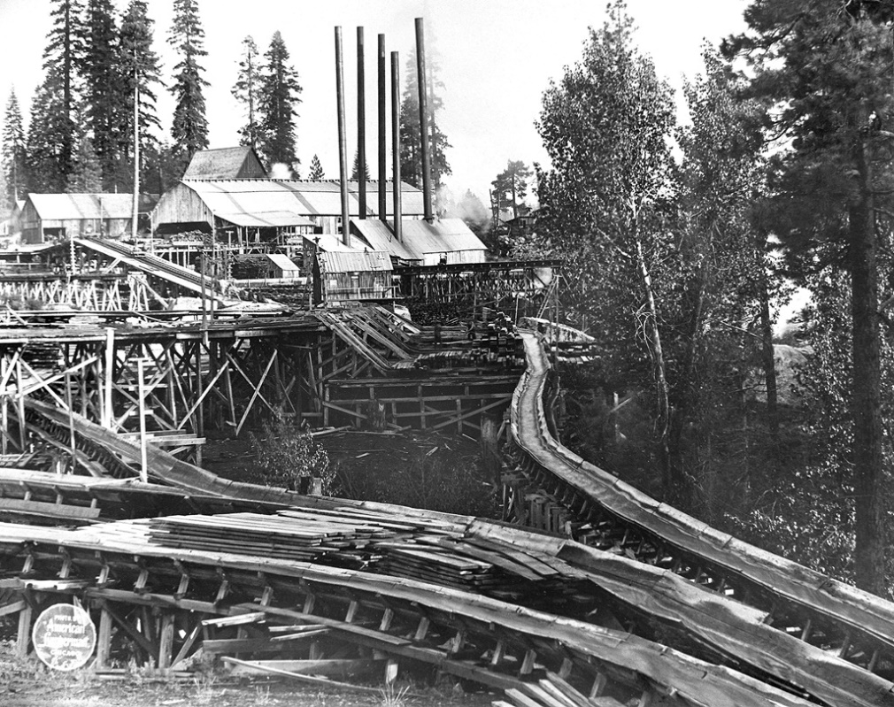
Logstash Pipeline
Event processing pipeline has three stages:
Input: These ingest data, many options exists for different types
Filter: Take raw data and makes sense of it, parsing it into a new format
Output: Sends data to a stream, file, database or other places.
Input and output support codecs that allow you to encode/decode data as it enters/exits the pipeline.

Slide 27
Logstash Processing Pipeline
Input | Filter | Output
Beats: Was used to bring in syslog messages from filebeat on the clients in its native format. | Grok: Used to split up the messages into fields Date: Used to process the timestamp into a date field | Elasticsearch: Dumped the data into elasticsearch to be able to pick it up with Kabana using the default json codec
https://www.elastic.co/guide/en/logstash/current/pipeline.html

Slide 28
Logstash Inputs
Beats: Receive events from Elastic Beats framework
Elasticsearch: Reads query results from Elasticsearch
Exec: Captures the output of a shell command
File: Streams events from a file
Github: Read events from a github webhook
Heroku: Steam events from the logs of a Heroku app
http: Events over HTTP or HTTPS
irc: Read events from an IRC server
pipe: Stream events from a command pipe
Puppet_factor: Read puppet facts
Rabbitmq: Pull events from a RabbitMQ Exchange
Redis: Read events from redis instance
Syslog: Read syslog messages
TCP: Read events from TCP socket
Twitter: Read Twitter Steaming API events
UDP: Read events over UDP
Varnishlog: Read from the varnish cache shared memory log
https://www.elastic.co/guide/en/logstash/current/input-plugins.html

Slide 29
Logstash Filters
Aggregate: Aggregate from several events originating from a single task
Anonymize: Replace values with consistent hash
Collate: Collate by time or count
CSV: Convert csv data into fields
cidr: Check IP against network blocks
Clone: Duplicate events
Date: Parse dates into timestamps
DNS: Standard reverse DNS lookups
Geoip: Adds Grographical information from IP
Grok: Parse data using regular Expressions
json: Parse JSON events
Metaevent: Add fields to an event
Multiline: Parse multiline events
Mutate: Performs mutations
Ruby: Parse ruby code
Split: Split up events into distinct events
urldecode: Decodes URL-encoded fields
xml: Parse xml into fields
https://www.elastic.co/guide/en/logstash/current/filter-plugins.html
Notes:
Common mutations: join, lowercase/uppercase, remove_tag, remove_field, replace, split, strip

Slide 30
Logstash Outputs
CSV: Events are written into lines in a delimited file.
Cloudwatch: AWS monitoring platform integration.
Email: Sends an email to specified address with the output of the event.
Elasticsearch: The most commonly used output, at least for the ELK stack.
Exec: Run a command based on the event data.
File: Glob events into a file on the disk.
http: Send events to an http endpoint, this can be any http endpoint.
Jira: Create issues in jira based on events.
MongoDB: Write events into MongoDB
RabbitMQ: Send events into a RabbitMQ exchange
S3: Store events as files in an AWS s3 bucket. This can be streamed in/out, very handy for pipelining.
Syslog: Sends event to a syslog server.
Stdout: Very useful while debugging your logstash chains.
tcp/udp: Writes event over socket, typically as json.
https://www.elastic.co/guide/en/logstash/current/output-plugins.html
Notes:
Typical output codec is jsonish

Slide 31
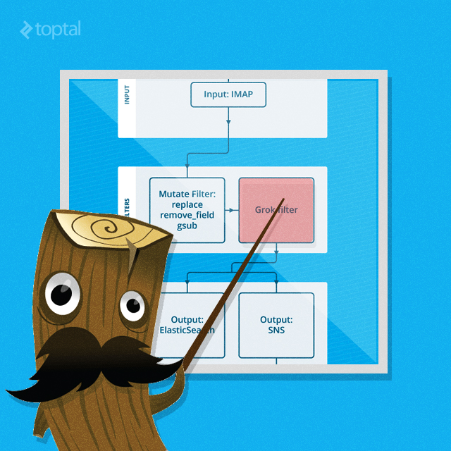
Enriching Data with Logstash Filters
Grok: Uses regular expressions to parse strings into fields, this is very powerful and easy to use. Stack grok filters to be able to do some very advanced parsing. Handy Grok Debugger: http://grokdebug.herokuapp.com/
Drop: You can drop fields from an event, this can be very useful if you are trying to focus your filters.
Elasticsearch: Allows for previously logged data in logstash to be copied into the current event.
Translate: Powerful replacement tool based on dictionary lookups from a yaml or regex.

Slide 32
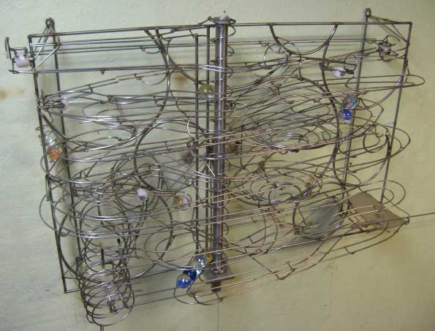
Log Shipping Overview
Log shippers pipeline logs into logstash or directly into Elasticsearch. There are many different options with overlapping functionality and coverage.
Logstash: Logstash can be thought of as a log shipper and it is commonly used.
Rsyslog: Standard logshipper, typically already installed on most linux boxes.
Beats: Elastic’s newest addition to log shipping, lightweight and easy to use.
Lumberjack: Elastic’s older log shipper, Beats has replaced this as the standard Elastic solution.
Apache Flume: Distributed log collector, not very popular among the ELK community

Slide 33
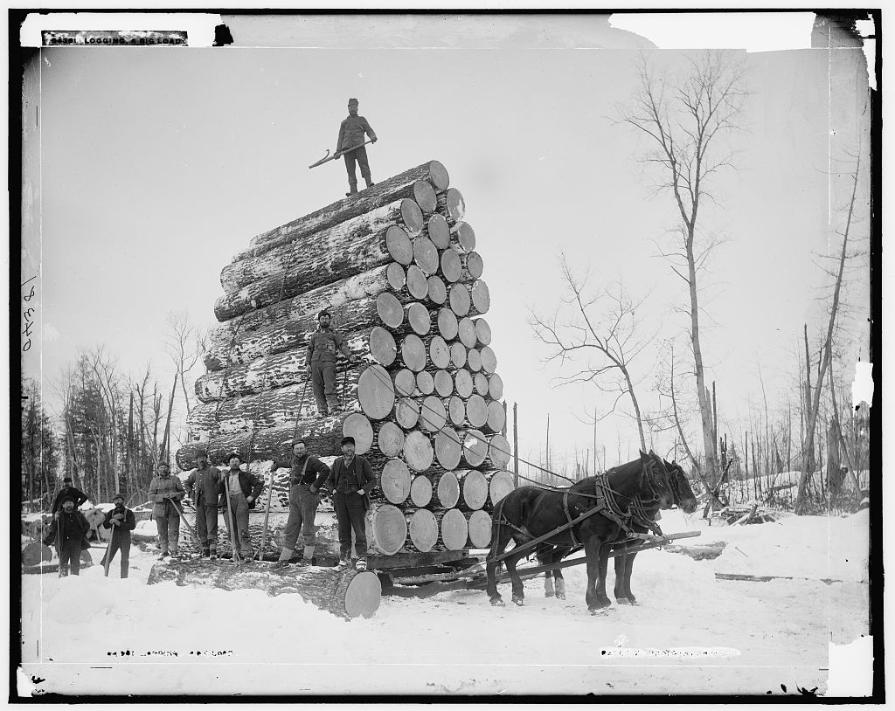
Logstash - Brokers
A must for production and larger environments.
Rsyslog & Logstash built-in queuing is not enough
Easy to setup, very high impact on performance
Redis is a good choice with standard plugins
RabbitMQ is also a great choice
These function as INPUT/OUTPUT logstash plugins
http://www.nightbluefruit.com/blog/2014/03/managing-logstash-with-the-redis-client/ http://dopey.io/logstash-rabbitmq-tuning.html

Slide 34
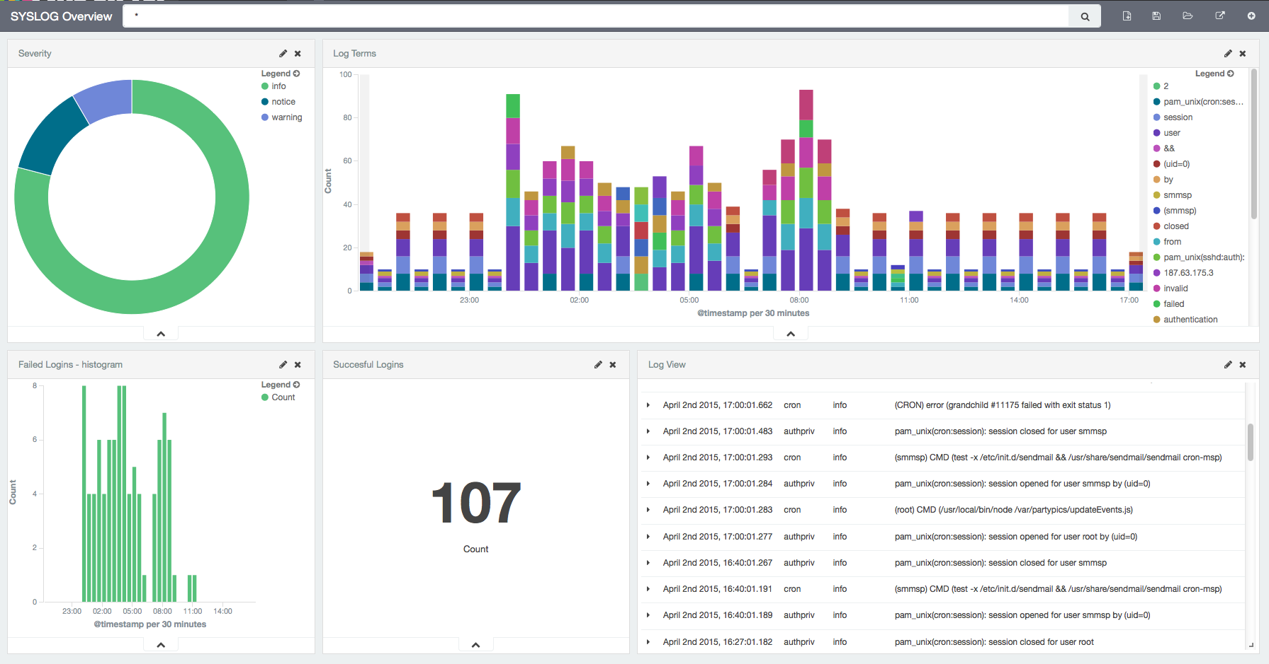
Rsyslog
Logstash Input Plugin for Syslog works well.
Customize Interface, Ports, Labels
Easy to setup
Filters can be applied in logstash or in rsyslog
Kibana view of syslog events.
https://www.elastic.co/guide/en/logstash/current/plugins-inputs-syslog.htmlç
Logstash Input Filter

Slide 35


Beats – A Closer Look
Filebeat: Used to collect log files.
Packetbeat: Collect Network Traffic
Topbeat: Collect System Information
Community Beats: Repo of Community Beats: https://github.com/elastic/beats/blob/master/libbeat/docs/communitybeats.asciidoc Beats Developers Guide: https://www.elastic.co/guide/en/beats/libbeat/current/new-beat.html
Apachebeat
Dockerbeat
Execbeat
Factbeat
Nginxbeat
Phpfpmbeat
Pingbeat
Redisbeat
Notes:
Beats is written in Golang, most are very well documented.

Slide 36
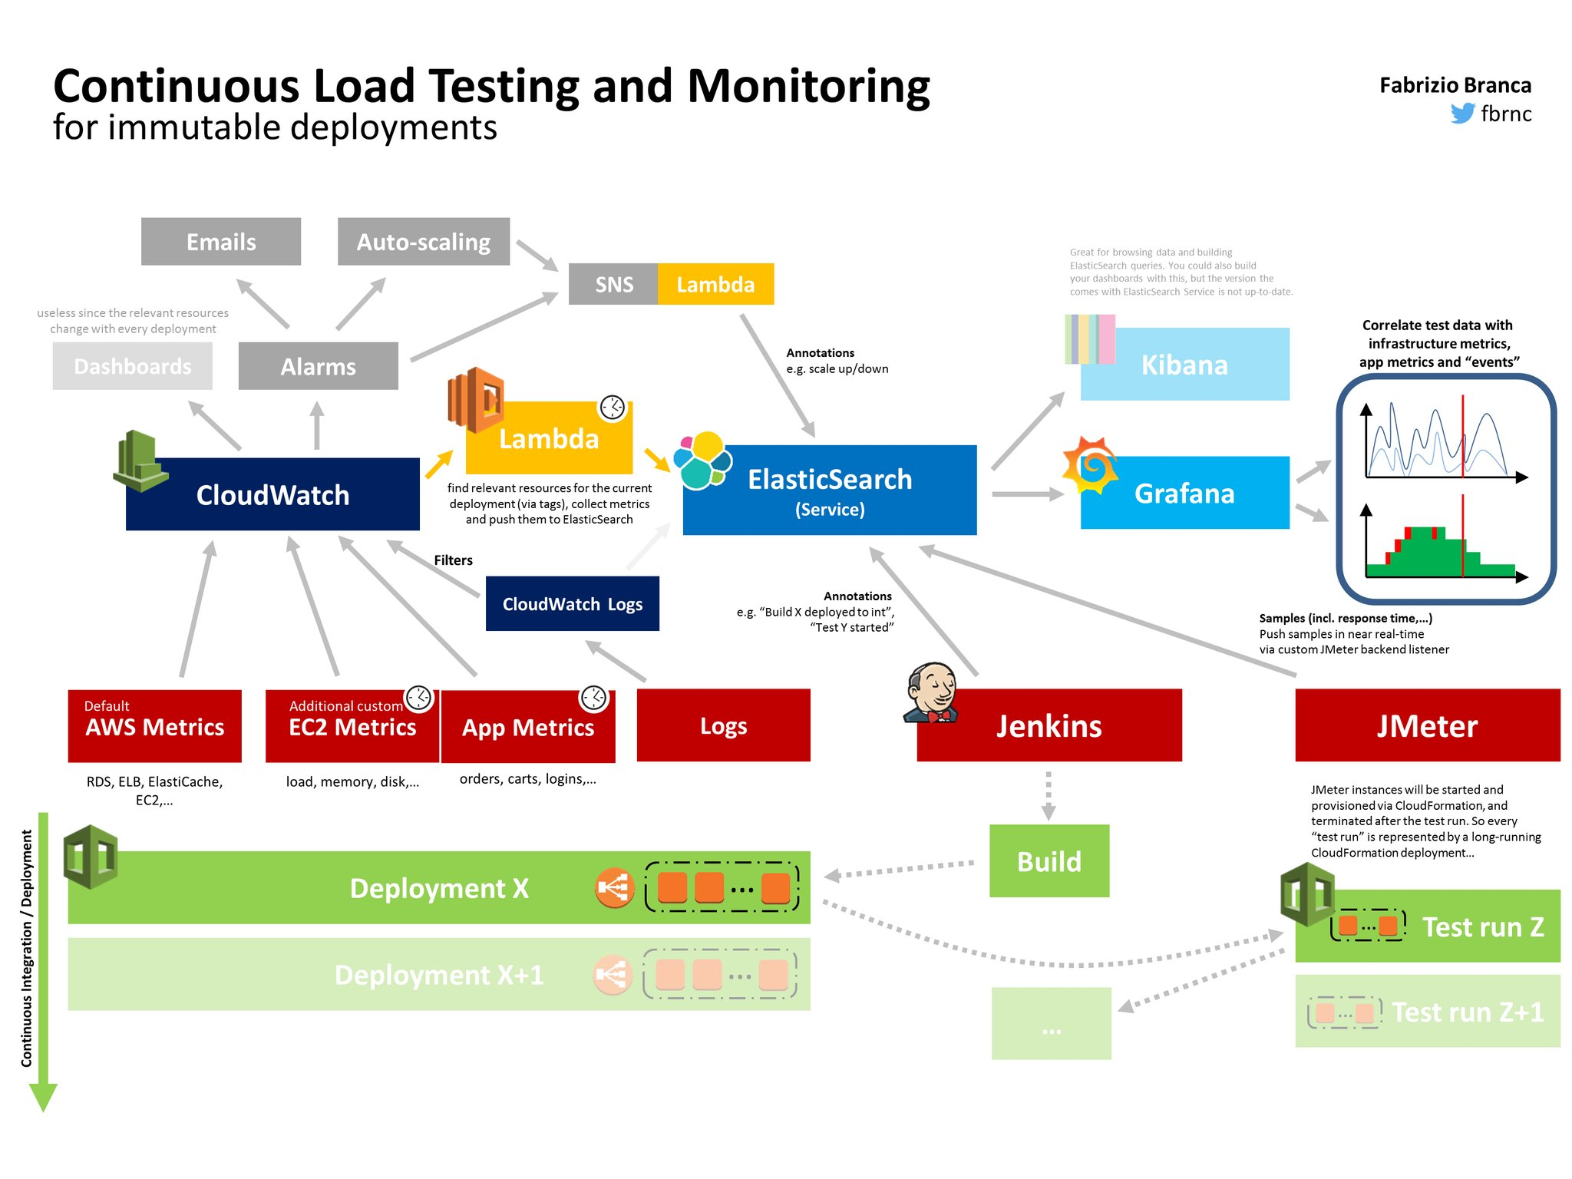
http://fbrnc.net/blog/2016/03/continuous-load-testing

Slide 37
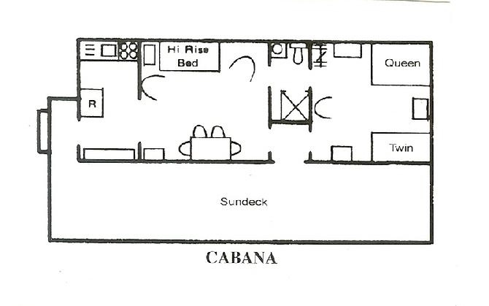
Kibana Overview
Kibana Interface has 4 Main sections:
Discover
Visualize
Dashboard
Settings
Some sections have the following options:
Time Filter: Uses relative or absolute time ranges
Search Bar: Use this to search fields, entire messages. Its very powerful
Additional save/load tools based on search or visualization.

Slide 38
Kibana Search Syntax
Search provides an easy way to select groups of messages.
Syntax allows for booleans, wildcards, field filtering, ranges, parentheses and of course quotes
https://www.elastic.co/guide/en/kibana/3.0/queries.html
Example:
type:“nginx-access” AND agent:“chrome”

Slide 39
Kibana Discover
Build searches to use in your visualizations and dashboards
Learn more about the data structure quickly
Dig into fields that you have ingested using logstash

Slide 40
Kibana Visualize
These are widgets that can be used on the dashboards
Based on the fieldsets in your index
Too complex to go into any details in this presentation
https://www.elastic.co/guide/en/kibana/current/visualize.html

Slide 41
Kibana Dashboard
Built from visualizations and searches
Can be filtered with time or search bar
Easy to use
Once you have a good handle on visualizations your dashboards will look great

Slide 42
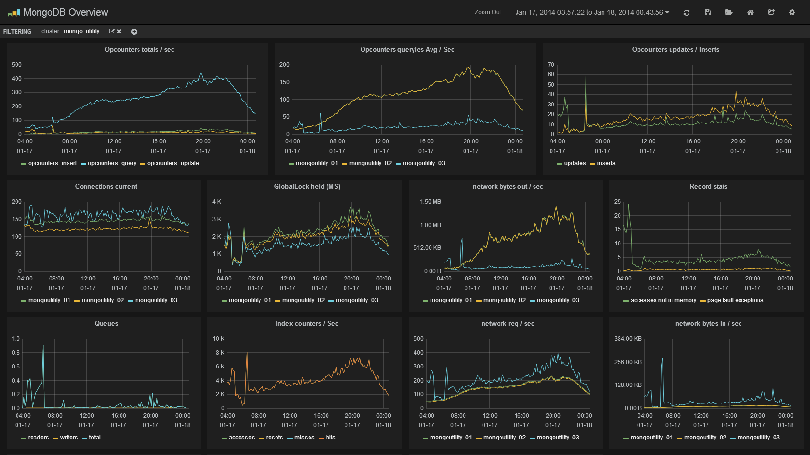

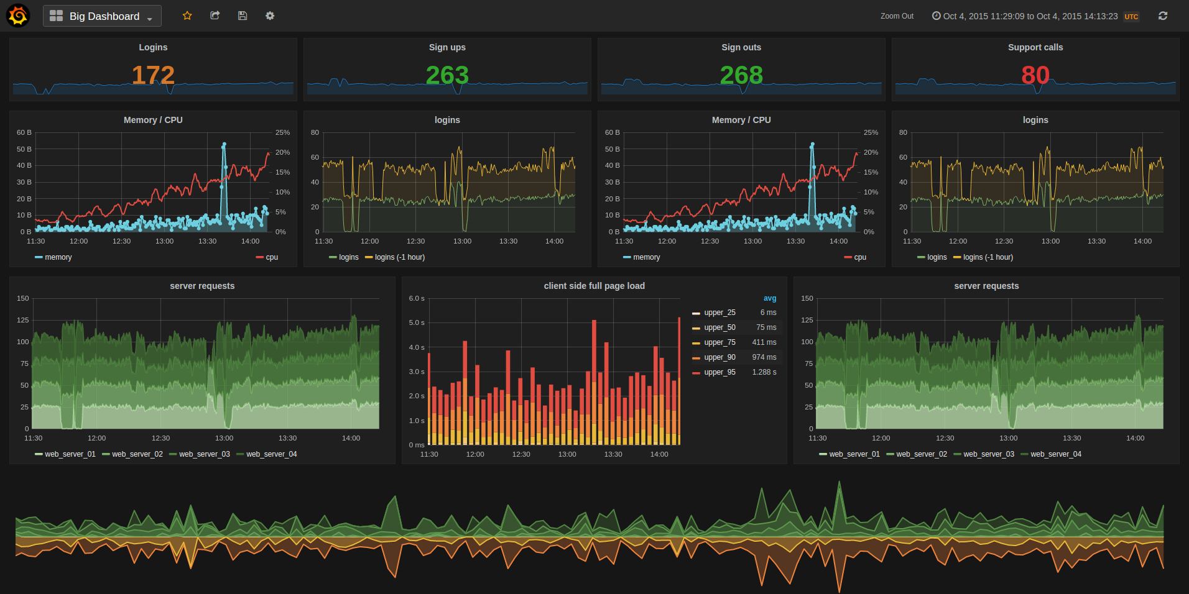
Grafana
Rich Graphing with lots more options compared to Kibana
Mixed style graphs with easy templating, reusable and fast
Built in authentication, allows for users, roles and organizations and can be tied to LDAP
Annotations and Snapshot Capabilities.
Kibana has better Discovery

Slide 43

Recap / QA
Easy to setup ELK initially
Scaling presents some challenges, solutions exist and are well documented
Using ELK in production requires several additional components.
Setup ELK and start playing today

Slide 44
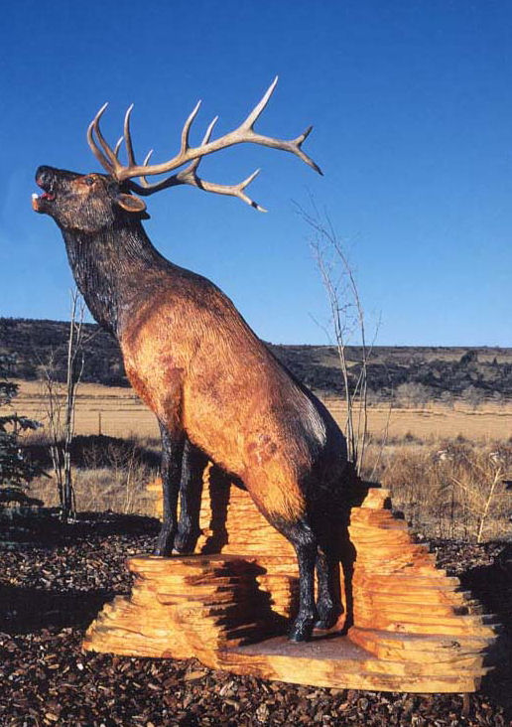
Thanks / QA
Thanks to :
My Family
Robofirm Midwest PHP
The Magento Community
Fabrizo Branca
Tegan Snyder
Logz.io
Digital Ocean
Last but not least: YOU, for attending.
ELK: Ruminating On Logs
Rate this talk:
https://joind.in/event/midwest-php-2016/elk-ruminating-on-logs
Mathew Beane <mbeane@robofirm.com>
Twitter: @aepod
Blog: http://aepod.com/

Slide 45
Attribution
Elk and Sparrows by benke33 http://img05.deviantart.net/c447/i/2014/029/d/9/elk_and_sparrows_by_benke33-d747i3q.jpg
Elk Vs Tree http://www.prairiestateoutdoors.com/images/uploads/what_are_the_odds.jpg
ELK Carving http://www.thelogcrafter.com/lifesizeelk.jpg
ELK simple flowchart http://www.sixtree.com.au/articles/2014/intro-to-elk-and-capturing-application-logs/
Drawing in Logs http://images.delcampe.com/img_large/auction/000/087/301/317_001.jpg
Logging Big Load https://michpics.files.wordpress.com/2010/07/logging-a-big-load.jpg
Moose tree accident http://www.skinnymoose.com/bbb/2010/04/01/trees-falling-on-elk-it-happens-more-than-you-think/
Logstash Enrichment Streamlining https://www.toptal.com/java/using-logstash-to-streamline-email-notifications
Docker Filebeat Fish https://github.com/bargenson/docker-filebeat
ELK Wrestling http://www.slideshare.net/tegud/elk-wrestling-leeds-devops
Log Yard http://proof.nationalgeographic.com/files/2013/12/007_Boreal-Forest_sRGB.jpg
Log Fire http://www.thestar.com/news/canada/2010/07/12/bc_sawmill_fire_contained_residents_allowed_home.html
Drawing in Logs http://images.delcampe.com/img_large/auction/000/087/301/317_001.jpg
Log Flume Mill http://historical.fresnobeehive.com/wp-content/uploads/2012/02/JRW-SHAVER-HISTORY-MILL-STACKS.jpg
Log Shipping Pie Graph https://sematext.files.wordpress.com/2014/10/log-shipper-popularity-st.png

